Slide 1
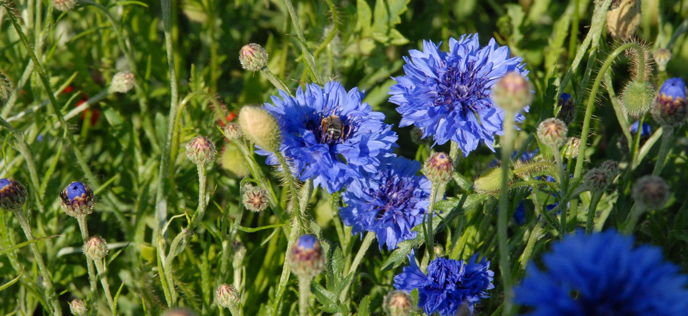
Make biodiversity in grape growing work for farmers
Dr. Kerstin Fröhle,
Lake Constance Foundation

Slide 2
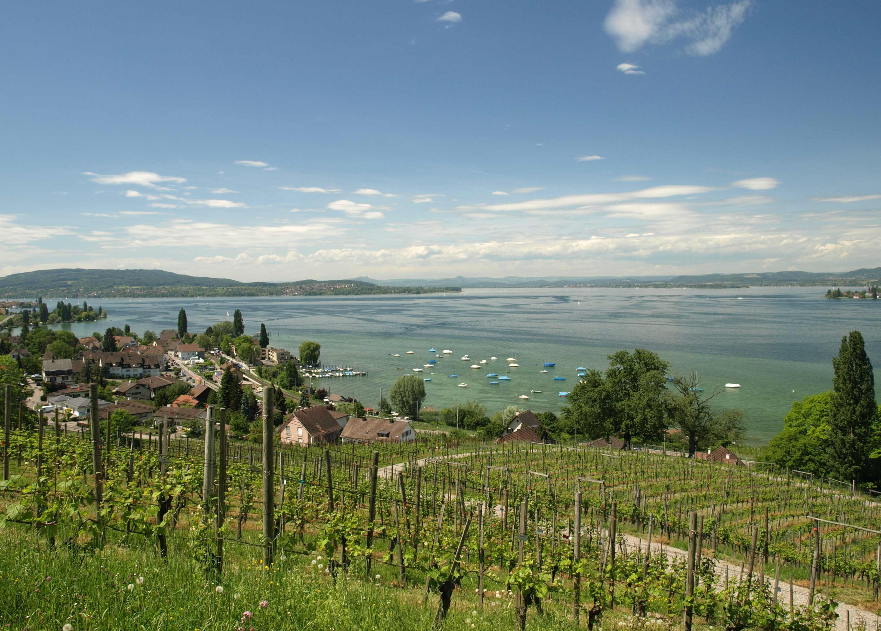
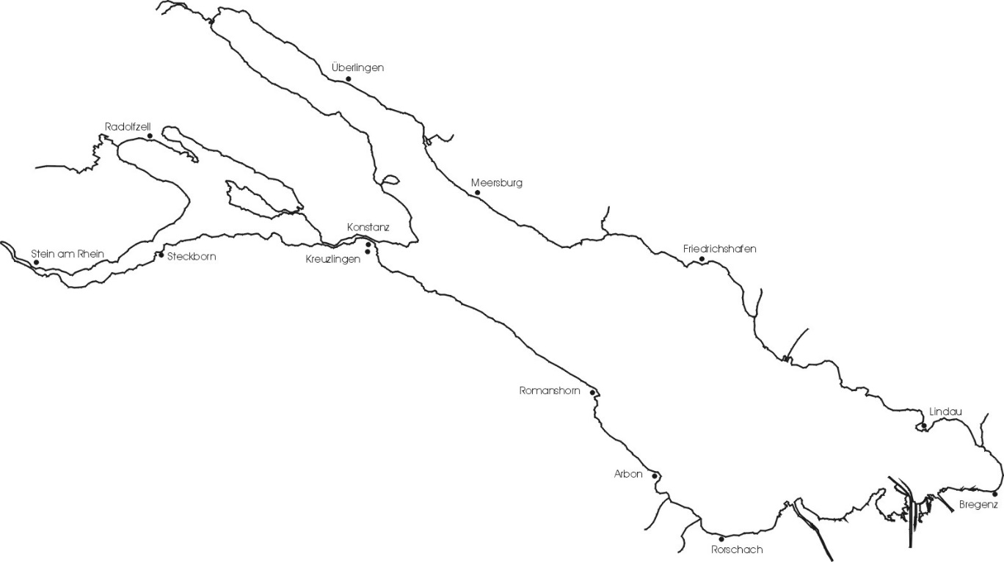
Lake Constance Foundation
Project-oriented organization for nature conservation
Goal: sustainable economy in the international Lake Constance area and beyond
Co-founders: 6-NGOs around the lake
Work areas: renewable energy, sustainable agriculture, business & biodiversity, lake conservation
D
CH
A

Slide 3
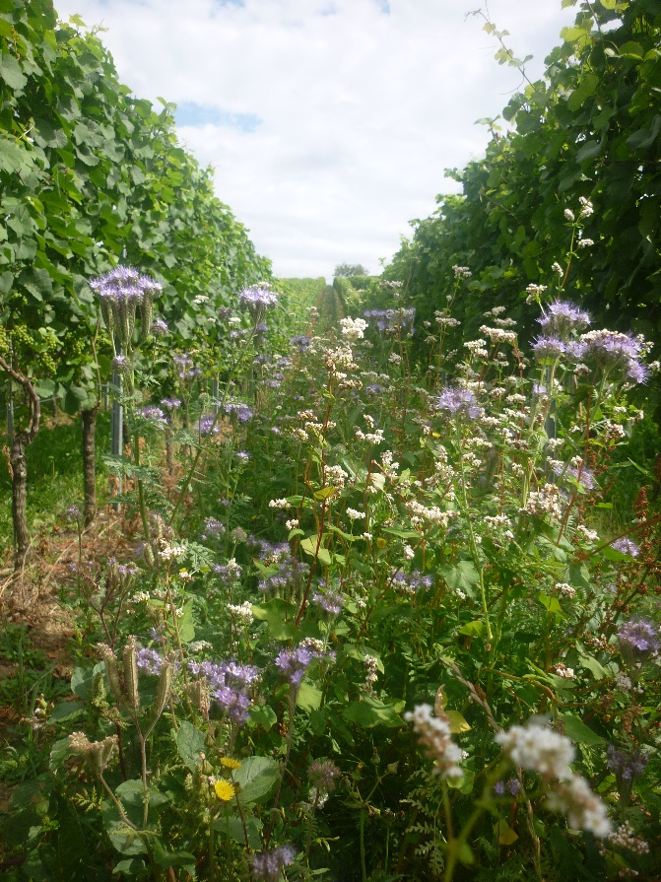
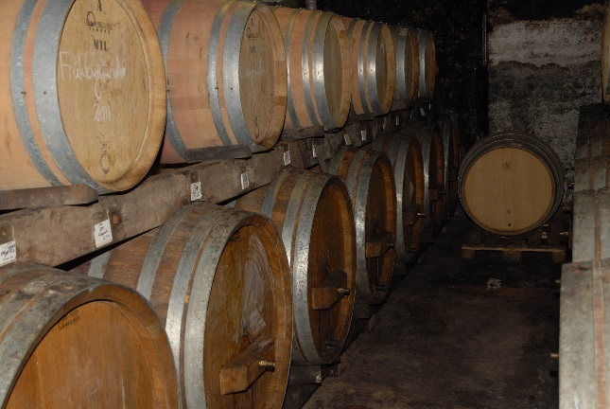
Partnership for Biodiversity Protection in Viticulture in Europe
Raise awareness
Adapt vine-growing practices to protect and promote biodiversity in the vineyard
Improve biodiversity performance beyond farm level
Project duration: Sep 2015 – Aug 2018;
Project number: 2015-1-DE02-KA202-002387

Slide 4
Partnership for Biodiversity Protection in Viticulture in Europe
Germany
Spain
Turkey
Portugal

Slide 5
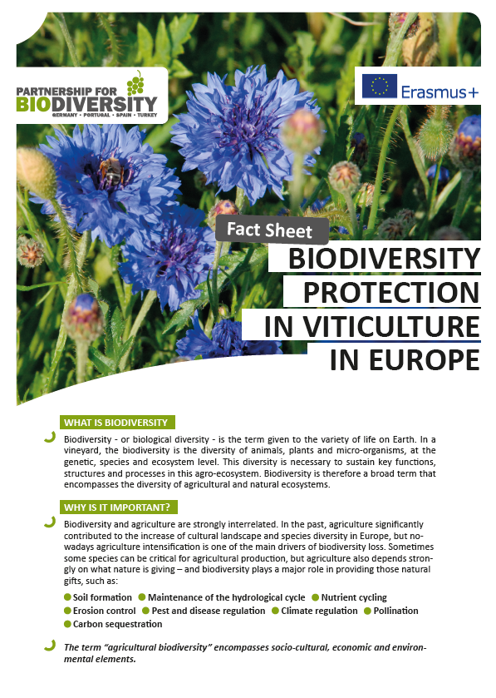
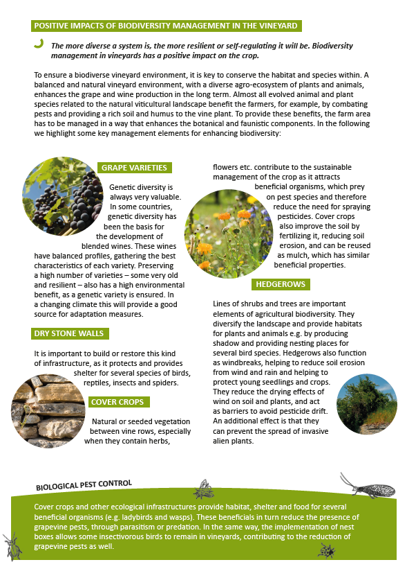
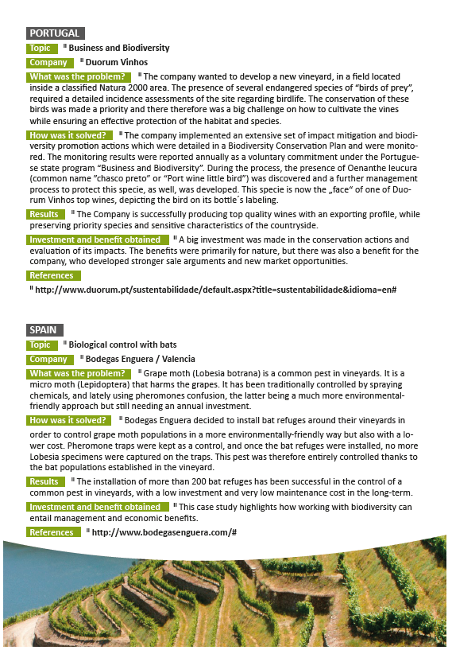
Different levels of getting farmers involved
Raising awareness: I. Fact Sheet – Biodiversity in viticulture

Slide 6
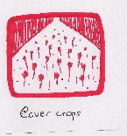
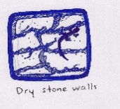
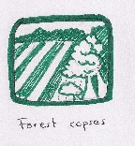
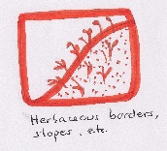
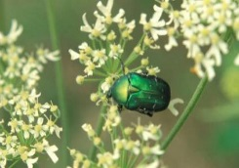
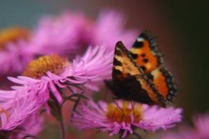
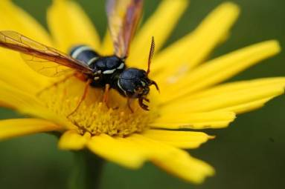
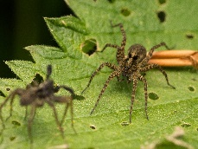
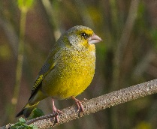
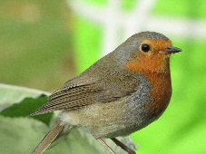
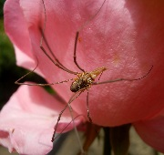
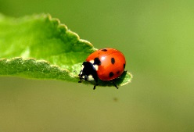
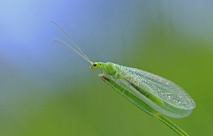
Different levels of getting farmers involved
Raising awareness: II. Identification Guide
Not a classical guide; we rather present the most know species and describe why they are important
Aim: show vine-growers that not all animals (or plants) they see in the vineyards are bad
Focus: Beneficials
Further information on pests and invasive species
Practical format - vine growers can put it into the pocket and take it to the field
Karl Dichtler / pixelio.de
Uwe-Jens Kahl / pixelio.de
M. Großmann / pixelio.de
Hans Peter Dehn / pixelio.de
uschi dreiucker / pixelio.de

Slide 7
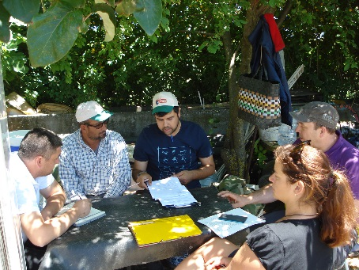
Different levels of getting farmers involved
III. Biodiversity Check - What is it?
Analysis of impacts (direct and indirect) of a winery on biodiversity
Offers an individual overview of the issue of biodiversity
Provides the basis for integrating biodiversity in the farm management
Does not issue a certificate or label
Does not substitute a biodiversity impact assessment
What is assessed?
Procedure
All stages of wine producing:
Mangement
Vineyard
Cellar, Vinification
Bottling, Packaging
Sales
Marketing
- Interview / field visits
- Report:
Summary of each area assessed
Positive and negative impacts
Recommendations for improvement
-Feedback from the farmer - teaching/training

Slide 8
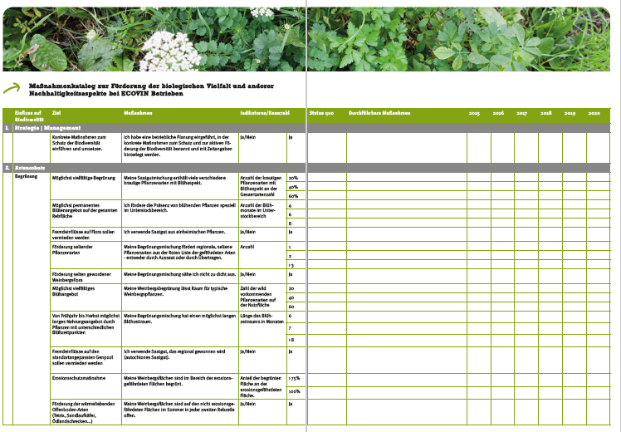
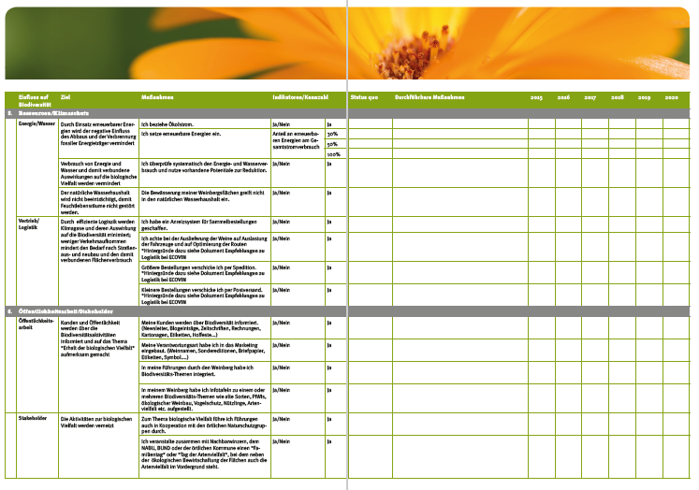
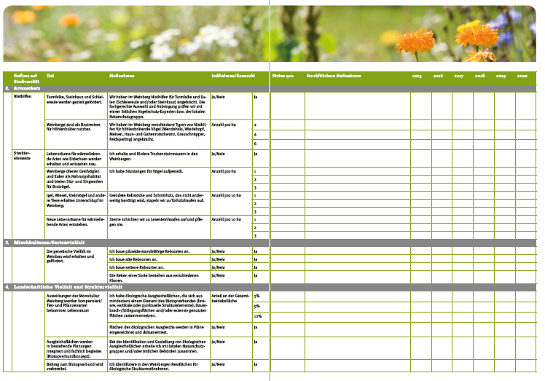
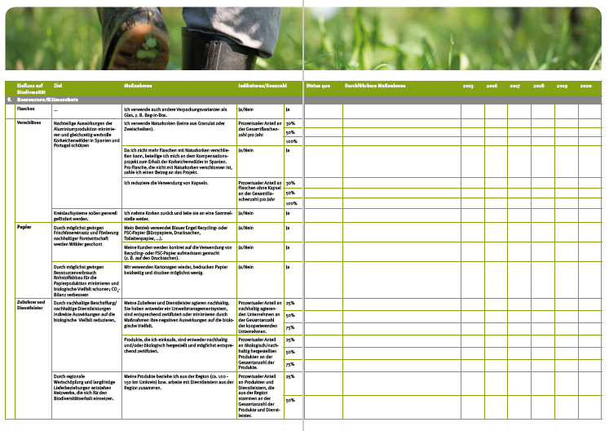
Different levels of getting farmers involved
IV. Biodiversity Programm

Slide 9
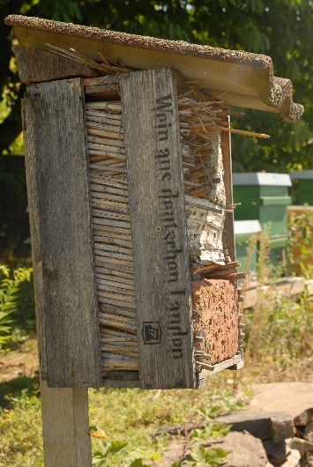
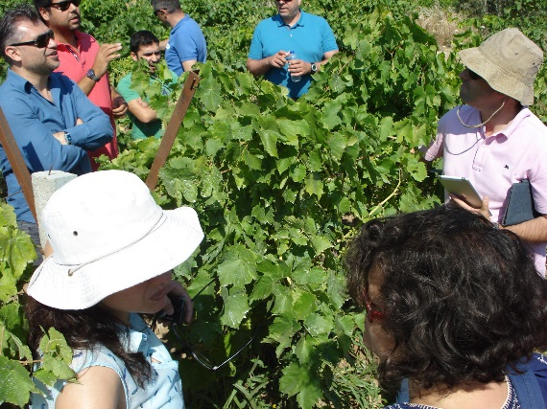
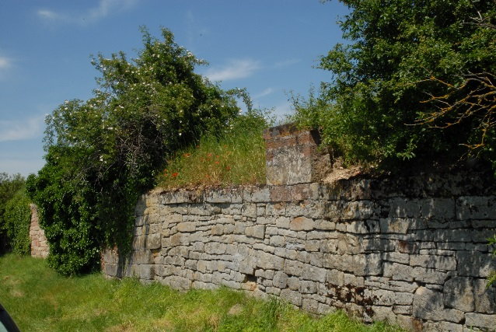
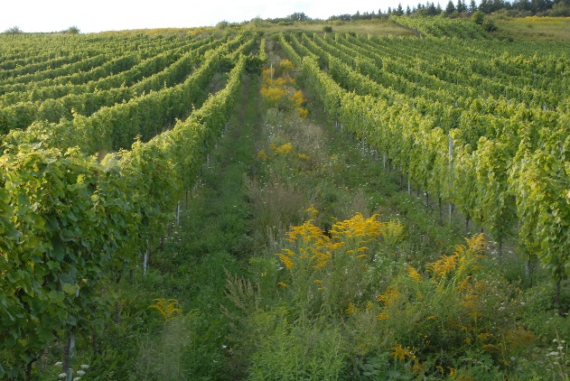
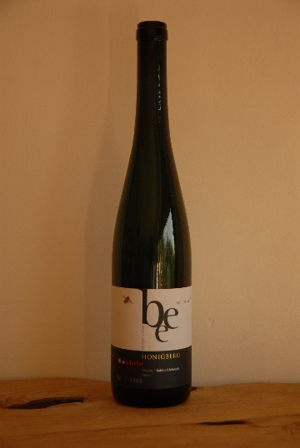
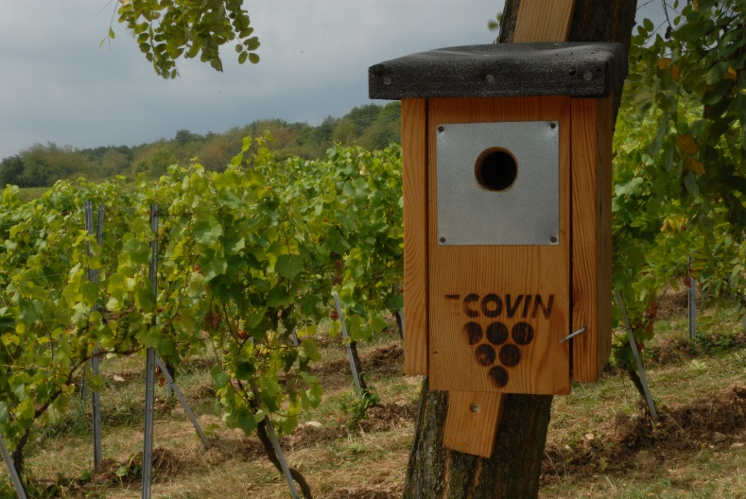
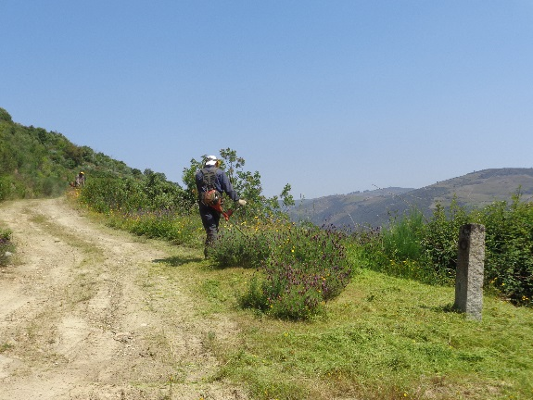
Thank you for your attention

