Slide 1

How the CAP is encouraging IPM grape growing in Italy
The Quality National System
Damiano Li Vecchi
Brussels, 7 February 2017

Slide 2
SQNPI
Since January 2016 the Quality National System for Integrated Production (SQNPI) complete the strategies for IPM in Italy.
Valorization of the agricultural & agro-food production:
  identification;
  boosting IPM production;
  let consumers know.
Compatible with agro-environment measures procedures under RDPs & CMO.
Simplification of administration and controls.

Slide 3
SQNPI
Law 3 February 2011 No 4
SQNPI institution;
IP definition.
Decree 8 May 2014
Structure and guideline for Technical Rules;
Techical-Scientifc Body;
CB requirement;
hallmark and rules of its utilisation;
equivalence with regional SQ.

Slide 4
SQNPI
The SQNPI foresees:
• Definition of National Guidelines to address the “Regional Technical Rules" on phytosanitary use.
They indicate intervention criteria, agronomic solutions and strategies to be adopted for crops protections and weeds control.
• The adoption of Regional IP disciplinary and the implementation of a traceability system aimed at demonstrating that the certified products come from farms that apply the above specifications.

Slide 5
SQNPI
Farmers can join the SQNPI either alone or in group (i.e. consortia, cooperatives, associations):
- simple procedures;
- interaction with SIAN and the farmer’s folder;
- application on-line (CAAs/POs).
In addition to farms also conditioners, processors, distributors may join the SQNPI .

Slide 6
SQNPI
SQNPI is designed to become a tool which also may help farmers:
to manage agro-environmental measures (RDPs);
to ensure equivalent relationship within regional QS;
to fulfil voluntary standards required by the main European supermarket chains;
to ensure the better application of Dir. 2009/128/EC.

Slide 7

Control system
The SQNPI provides for a double level of control designed to verify the application of the IP rules in several stages.
From the agricultural phase, processing, packaging, till the identification of the finished product identified through the hallmark "Sustainable Quality".

Slide 8
Control system
Holding self-control. It involves verifications of compliance made by the operators for the activities in their production sites (e.g. recording of farming operations, purchase and use of plant protection products; outcome of spray machines calibration; etc.).
Control by CB specifically authorized by the MiPAAF. Checks are carried out on 100% of the operators participating at the system.

Slide 9
Opportunities
SQNPI has been conceived to become a tool aimed at enhancing the knowledge and the differentiation of the products on the market.
The hallmark "Sustainable Quality" ensures consumers that the cultivation has been made with agricultural techniques which respect the environment and human health.
The SQNPI hallmark can also be used in conjunction with private or collective marks that define the product on the basis of different standards.

Slide 10







Opportunities
Producer
Processor
Distributor
Consumer
Distributor
Consumer

Slide 11
Opportunities
SQNPI allows, on one hand, to fulfil the legal obligations in the field of integrated pest management (IPM) and, on the other, to respond to the pressing demands from the market which is increasingly attentive to the methods of cultivation.
SQNPI also enables farms to access to public funding measures.
RD Measure for Quality schemes for agricultural products and foodstuffs – 3.000 €/year*.
RD Measure for Agro-environment – 900 €/ha*.
CMO Agro-environment on F&V – 900 €/ha*.
*maximum values

Slide 12
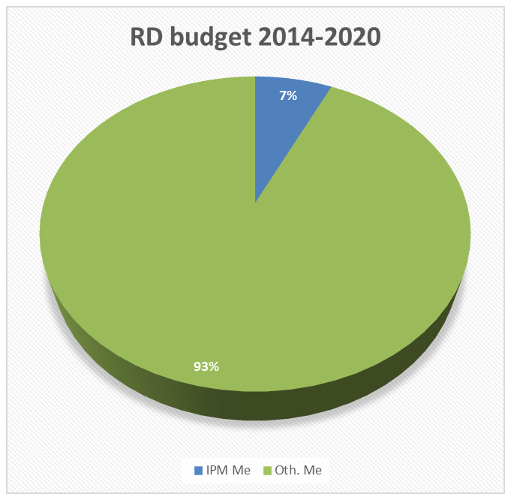
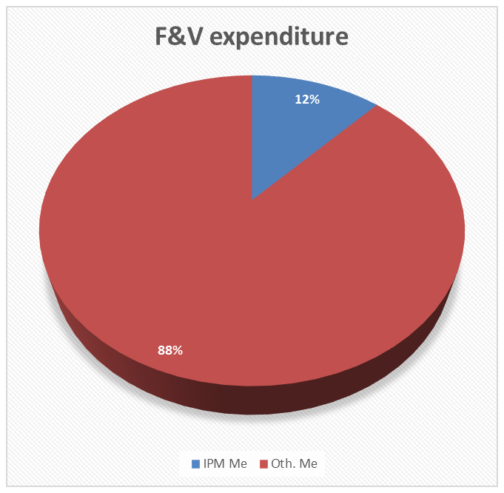
Opportunities
Amounts under IT RDPs & F&V for IPM

Slide 13
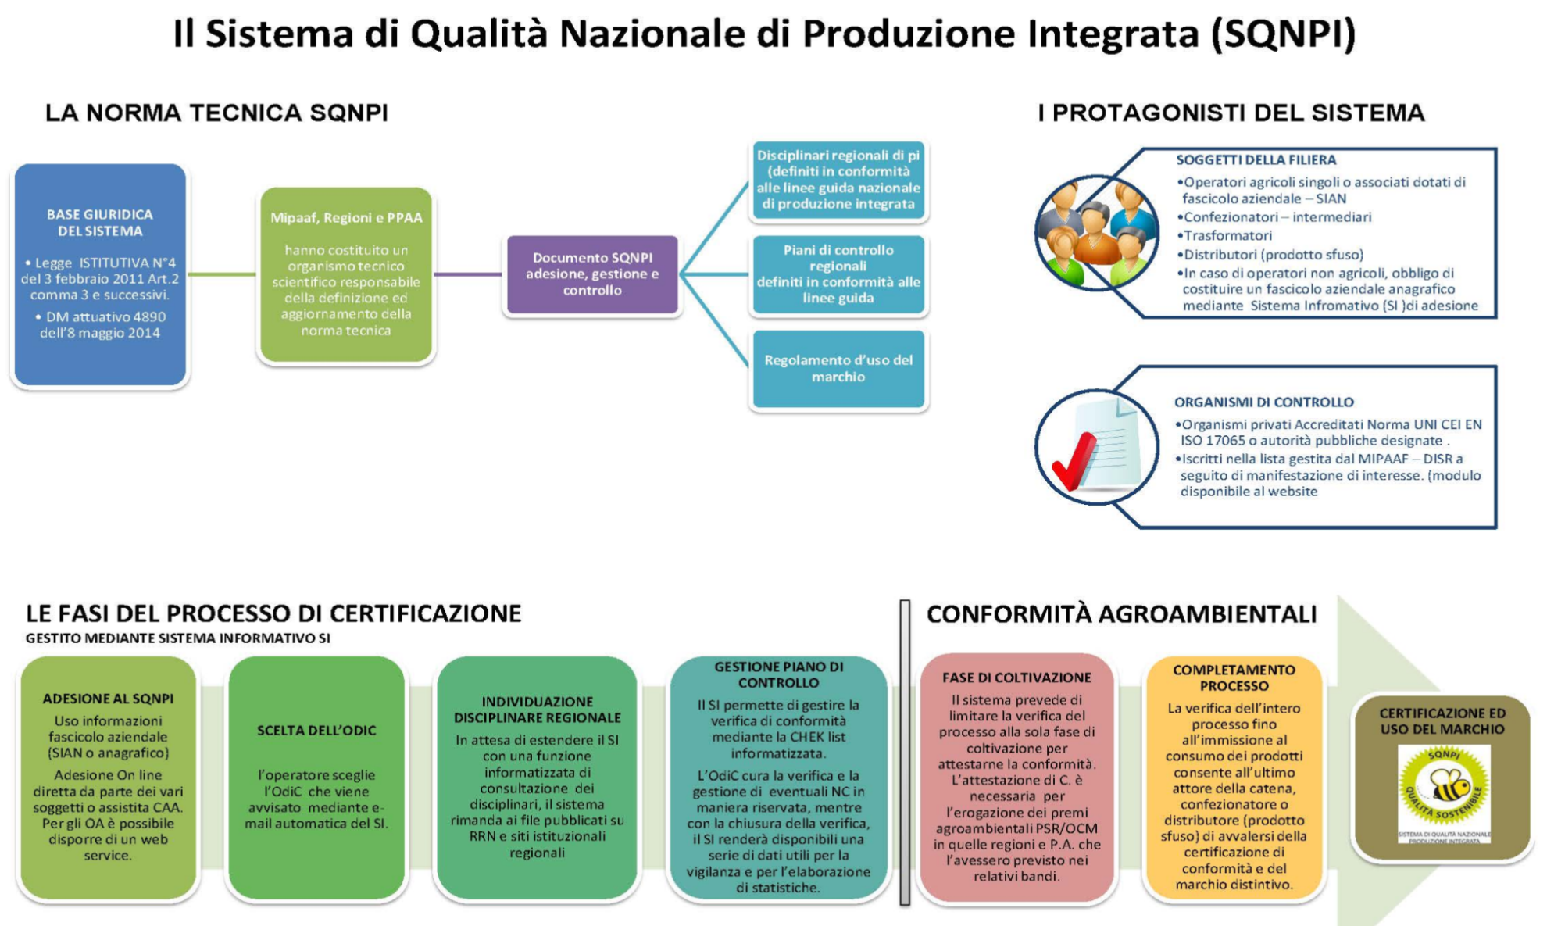
Conclusions

Slide 14
Many thanks for your attention
http://www.reterurale.it/produzioneintegrata

